Slide 1


CMU-CS 246 VIS
STORE MANAGEMENT SYSTEM (SMS)

Slide 2
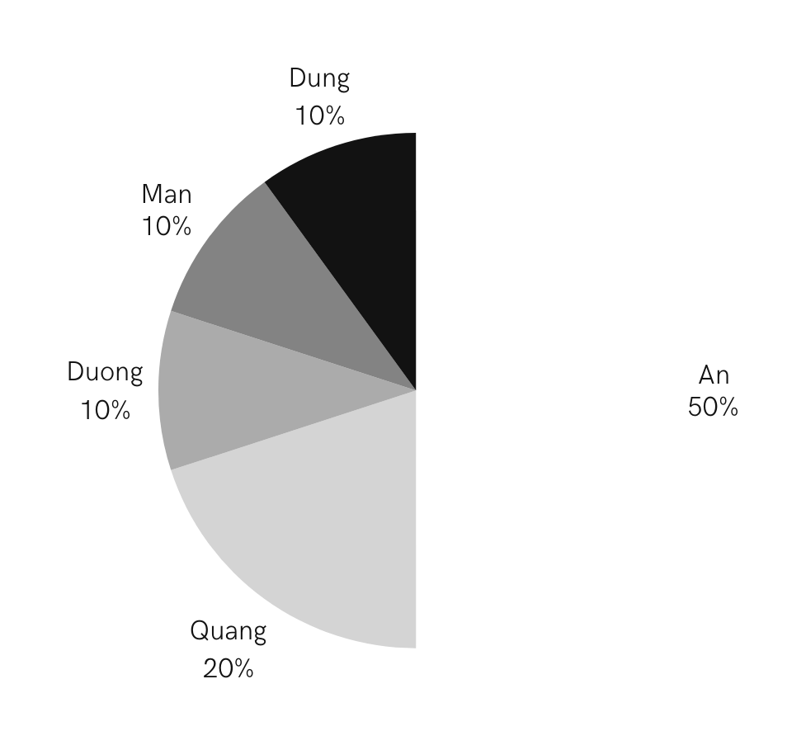
Group Member
GROUP IV
The group consists of 5 members:
Hoang Thanh An (Leader)
Tran Quoc Quang
Hoang Van Duong
Dao Tien Dung
Nguyen Viet Minh Man

Slide 3

What is phone store management?
Phone store manager is a position that plays an important role in the effective operation and development of a mobile phone store. They act as the "commander" of all store operations, including:
Employee management
Product management
Sales management
Financial management
Customer management
Marketing and promotion
Security

Slide 4
BENNEFIT
LIMIT
Optimize management
Investment costs
Save time and costs
Security risks
Improve business efficiency
The difficulty in using
Remote management
Depends on the service provider

Slide 5



Review
Phone store management application
Log in as administrator

Slide 6
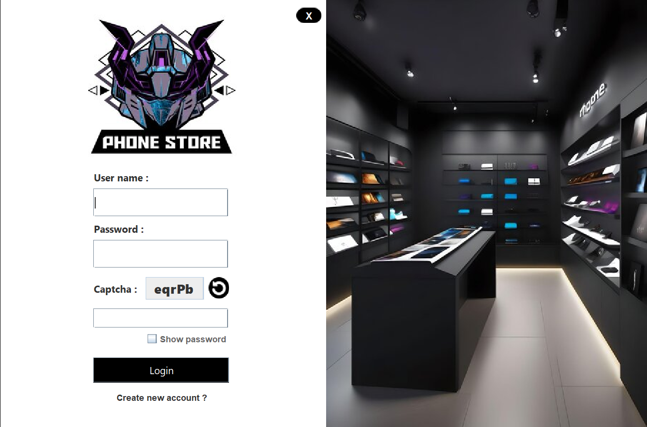

Slide 7
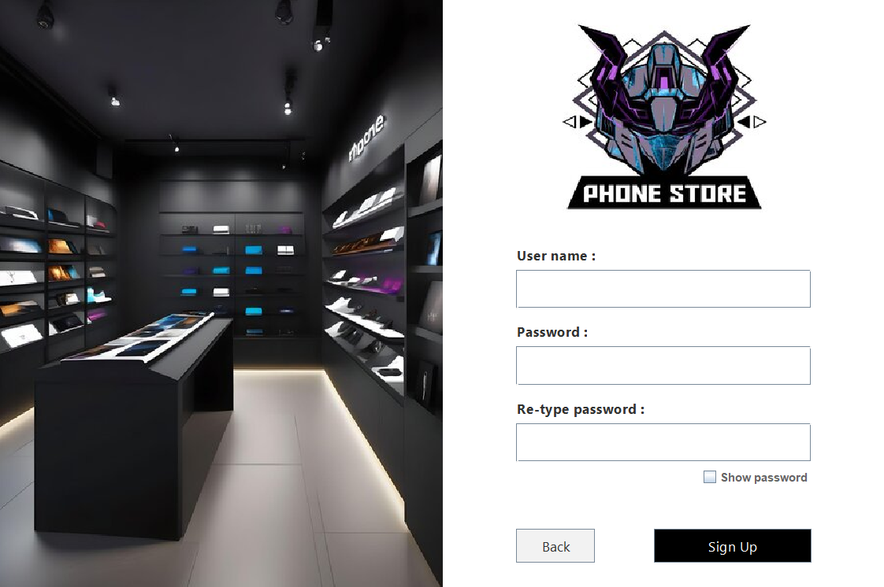

Slide 8
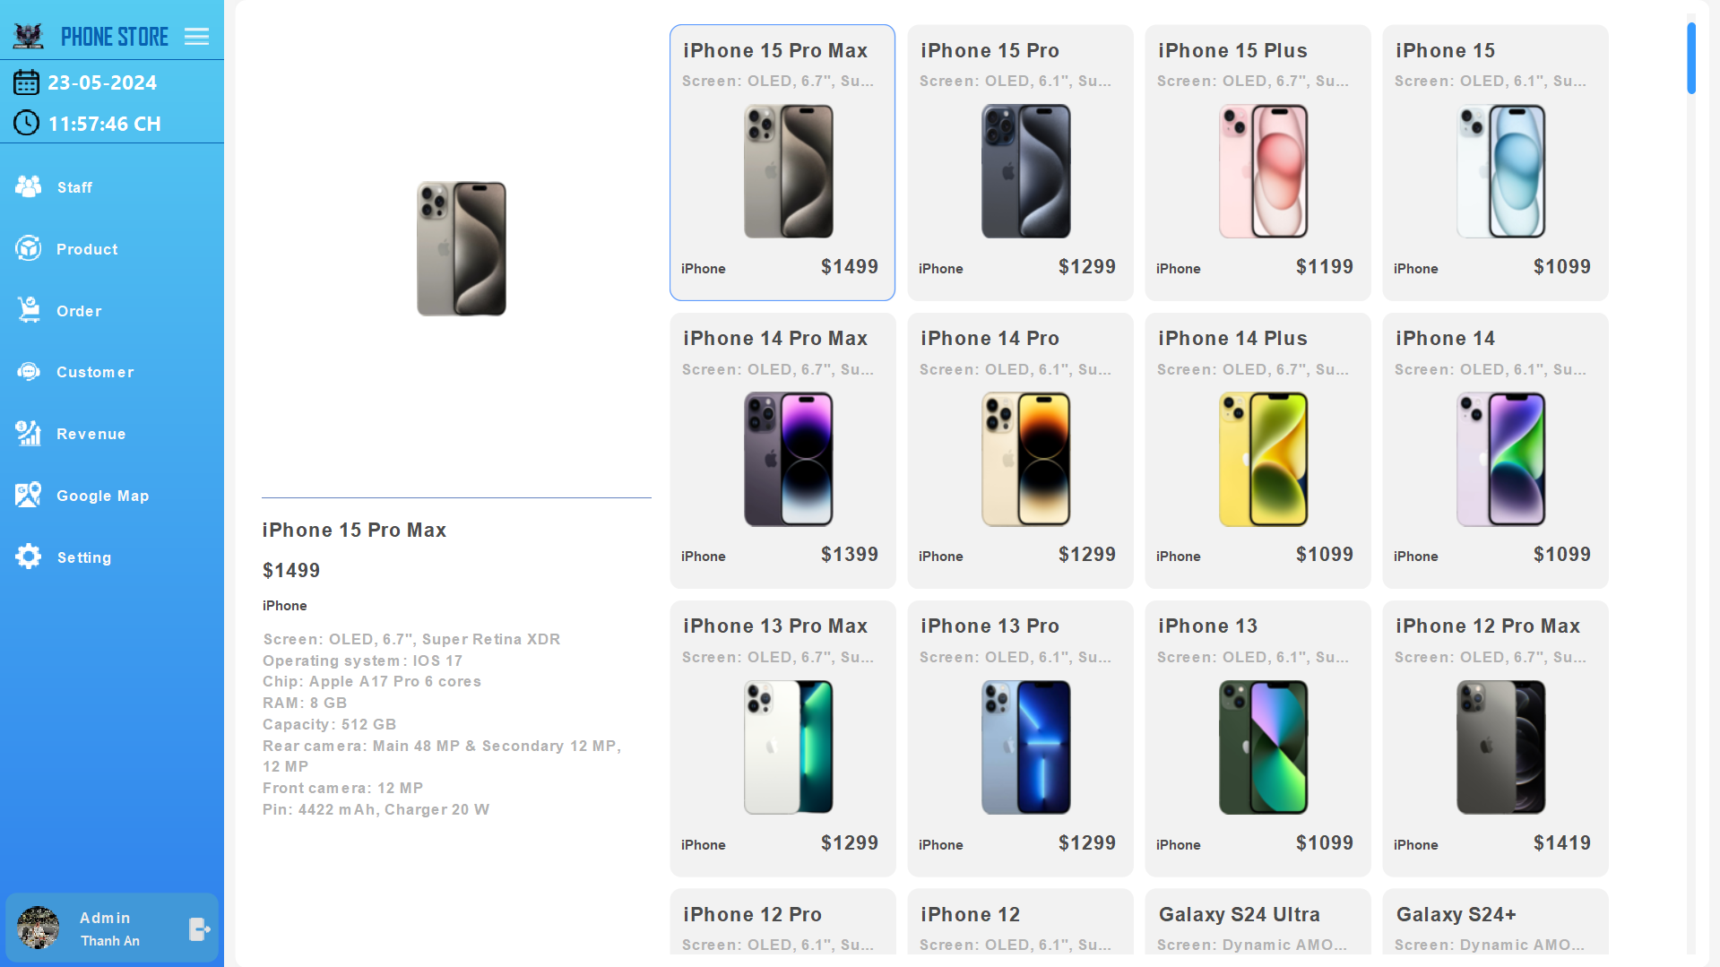

Slide 9
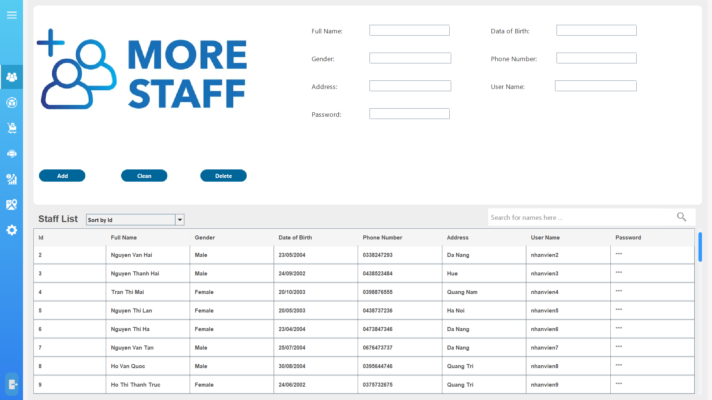

Slide 10
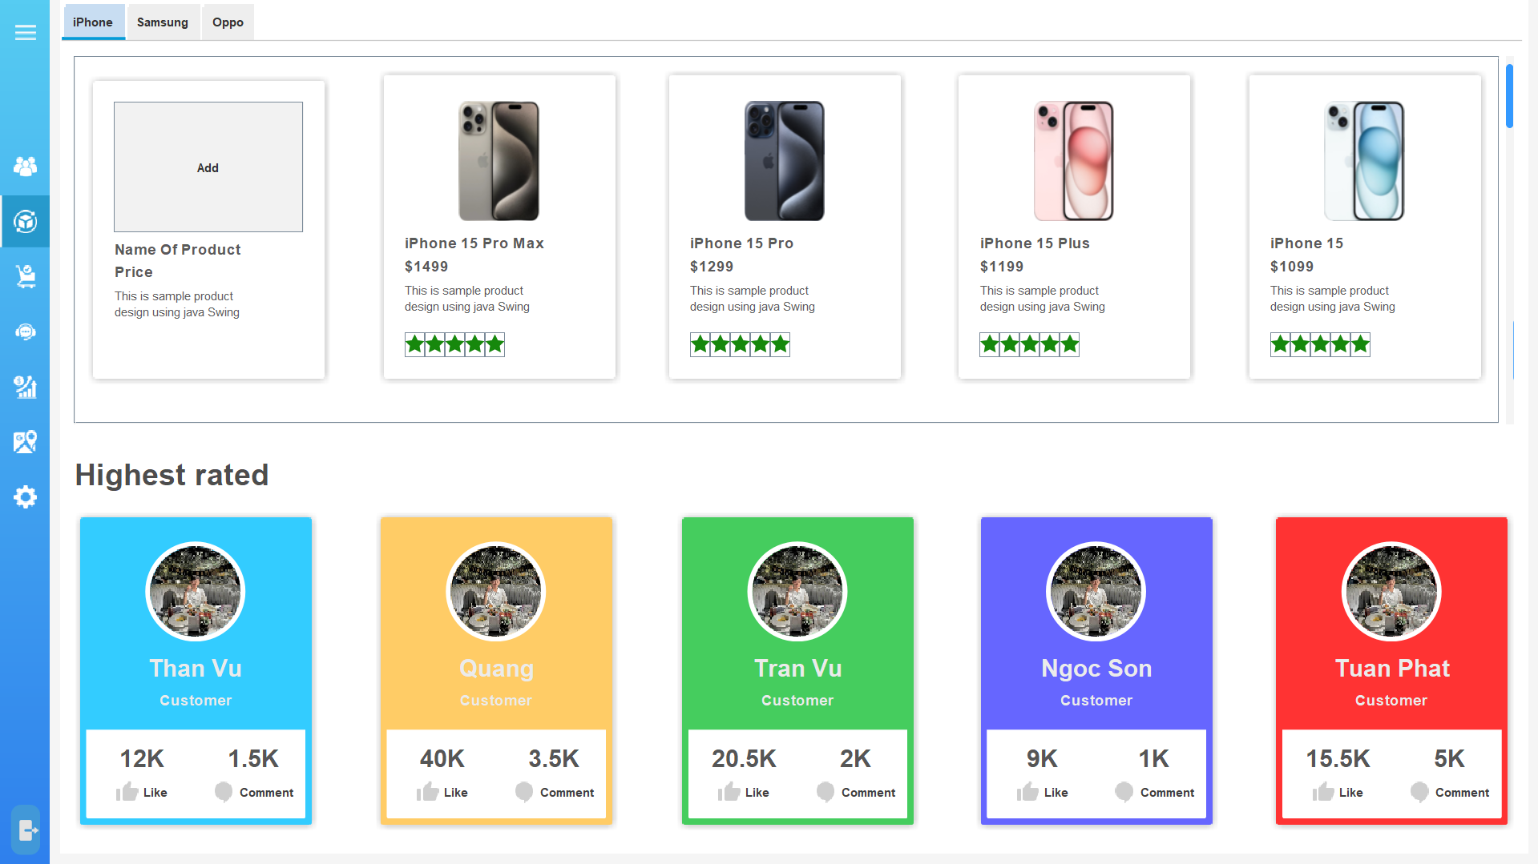

Slide 11
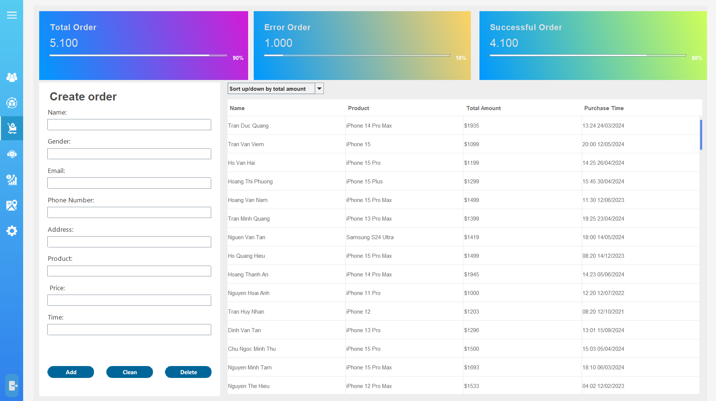

Slide 12
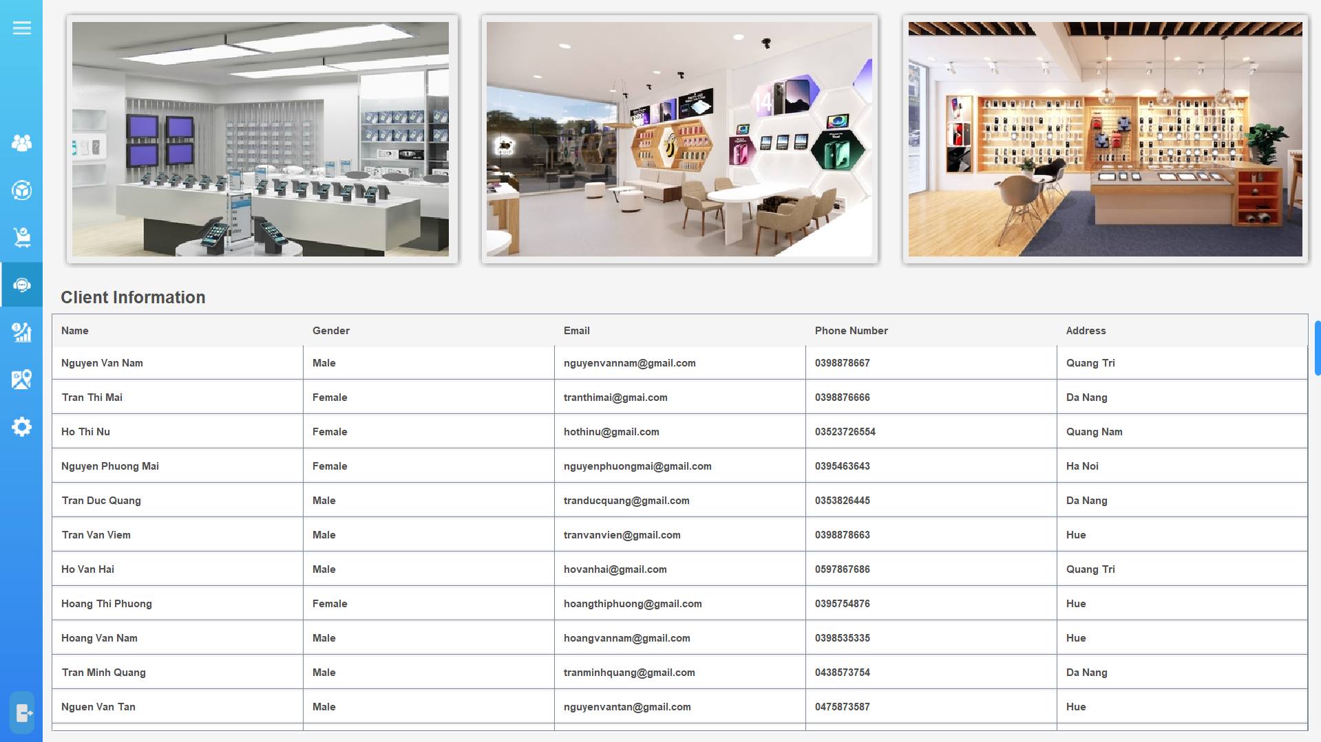

Slide 13
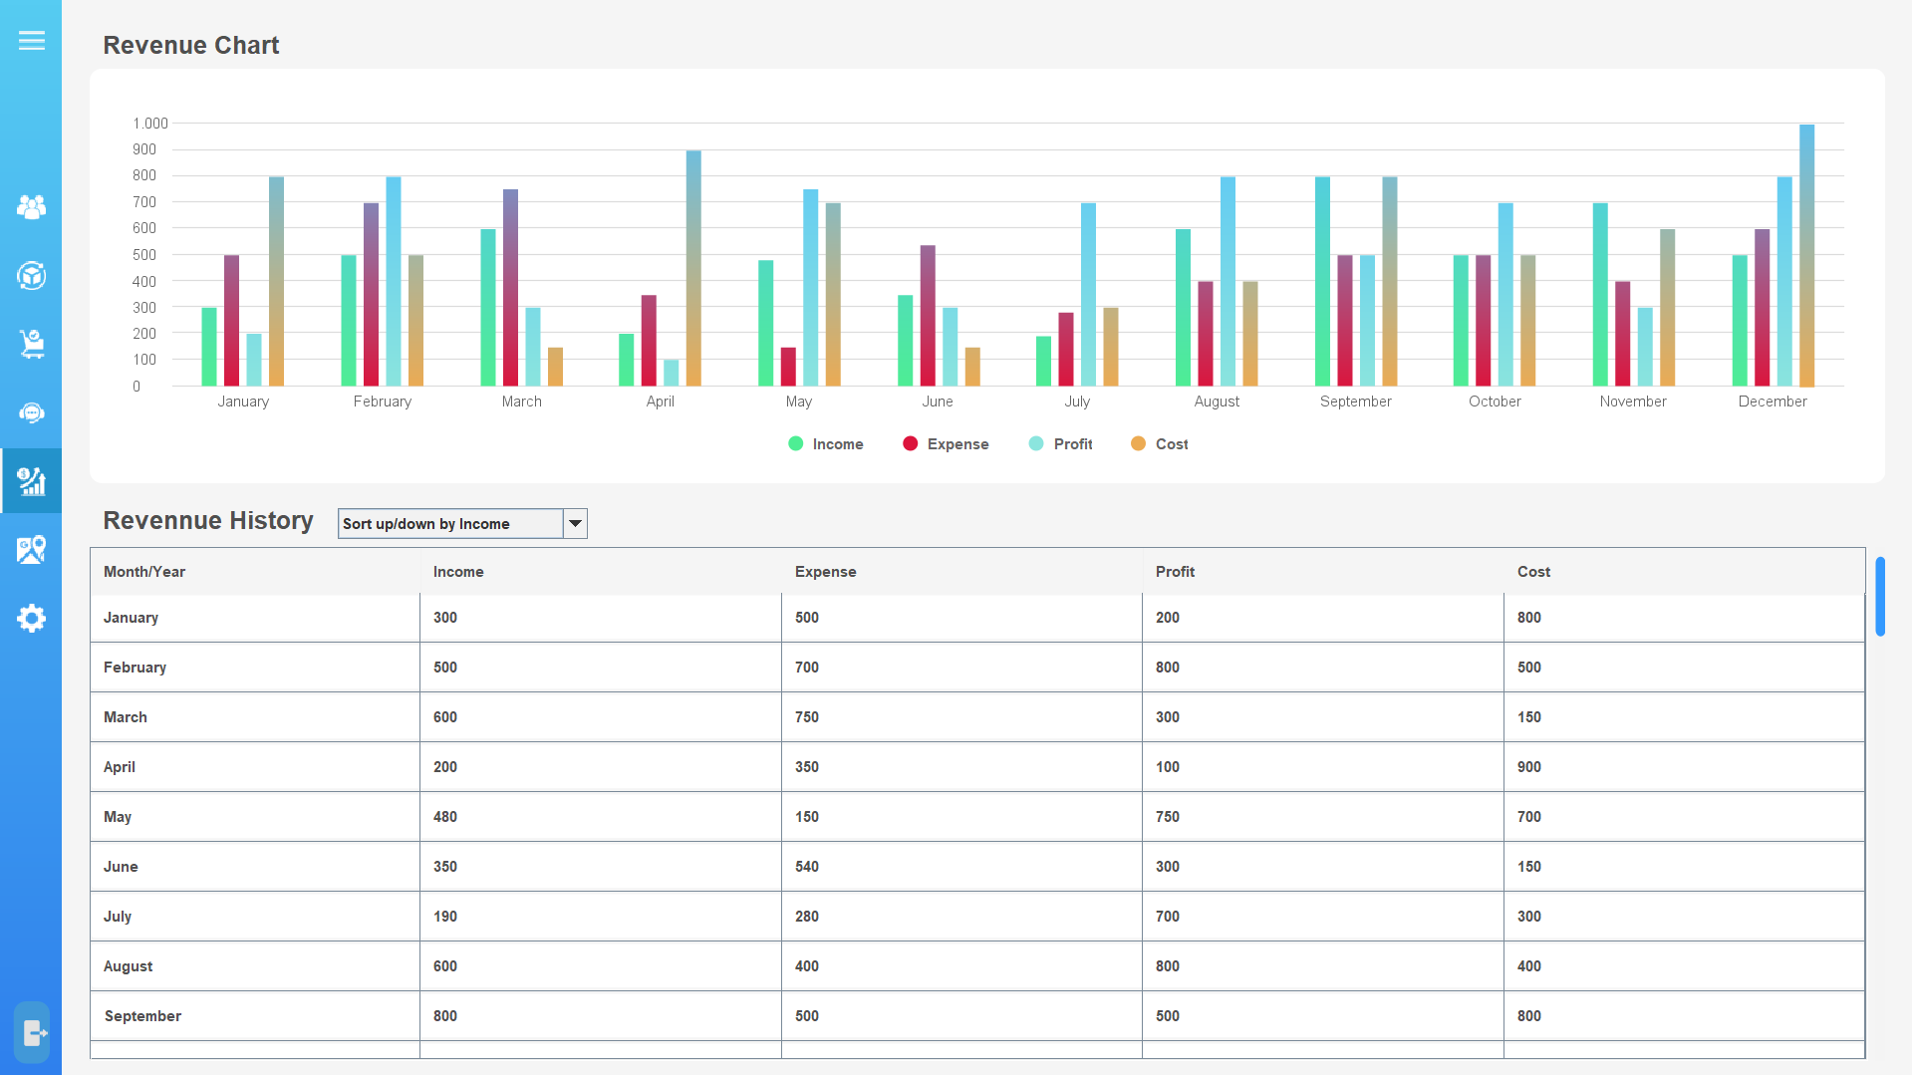

Slide 14
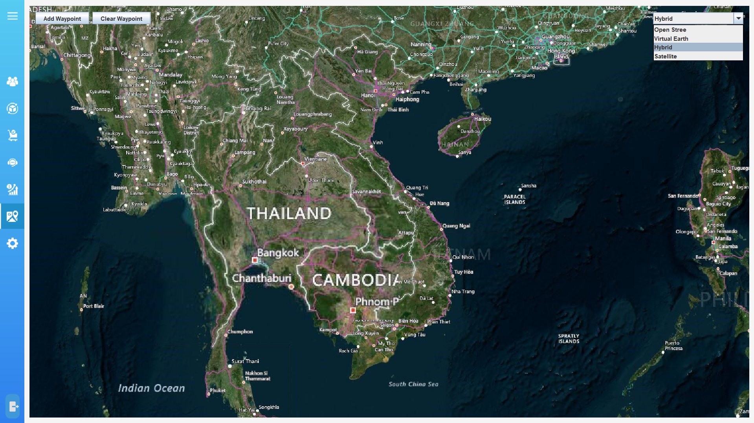

Slide 15
Review
Phone store management application
Log in as a sales staff

Slide 16
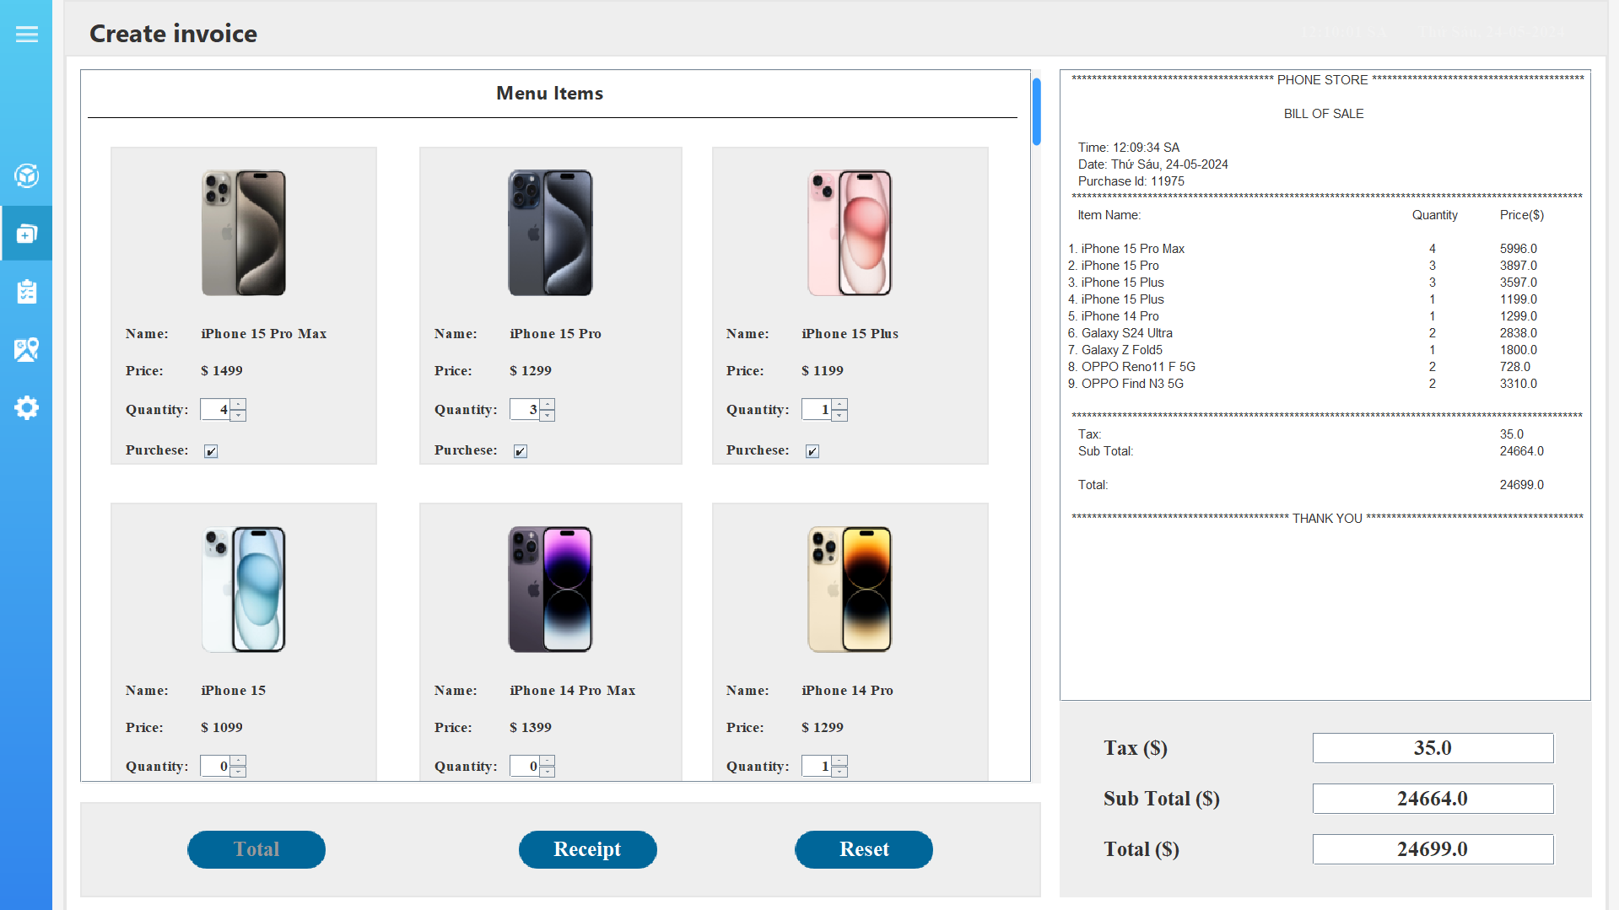

Slide 17
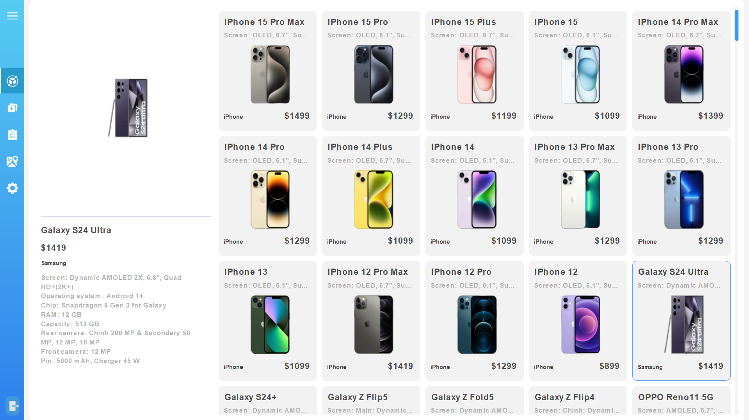

Slide 18
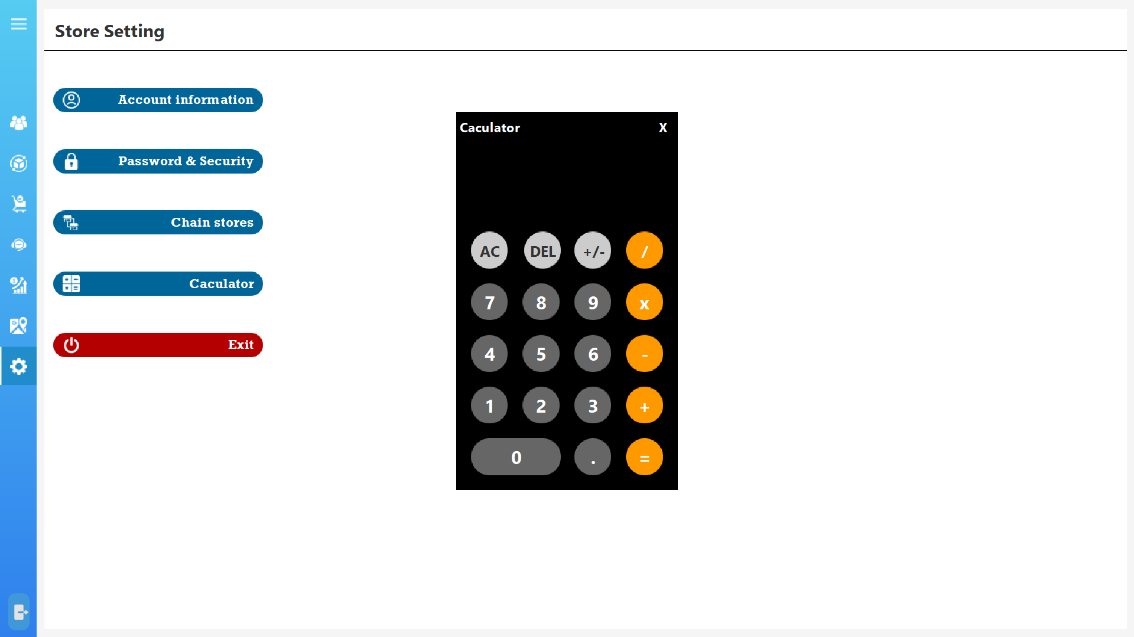

Slide 19



THANK
YOU

